Slide 1
OLAP and OLTP

Slide 2
OLTP Defined
OLTP or Online Transaction Processing is a type of data processing that consists of executing a number of transactions occurring concurrently—online banking, shopping, order entry, or sending text messages, for example. These transactions traditionally are referred to as economic or financial transactions, recorded and secured so that an enterprise can access the information anytime for accounting or reporting purposes.
https://www.oracle.com/ph/database/what-is-oltp/

Slide 3



Examples

Slide 4

What is OLAP?
Online analytical processing (OLAP) is software technology you can use to analyze business data from different points of view. Organizations collect and store data from multiple data sources, such as websites, applications, smart meters, and internal systems. (ex. Amazon Redshift, Snowflake)
https://aws.amazon.com/what-is/olap/

Slide 5



Slide 6
OLTP (Online Transaction Processing)
Optimized for fast writing and updating of data
Handles day-to-day transactions (e.g., orders, payments)
Uses row-based storage
Focuses on many small, quick operations
OLAP (Online Analytical Processing)
Optimized for reading and analyzing large amounts of data
Focuses on complex queries over large datasets
Uses column-based storage

Slide 7
Data Pipeline
A data pipeline is a method in which raw data is ingested from various data sources, transformed and then ported to a data store, such as a data lake or data warehouse, for analysis.
https://www.ibm.com/think/topics/data-pipeline

Slide 8
Data Pipeline types
Batch processing
As the name implies, batch processing loads “batches” of data into a repository during set time intervals, which are typically scheduled during off-peak business hours. This way, other workloads aren’t impacted as batch processing jobs tend to work with large volumes of data, which can tax the overall system. Batch processing is usually the optimal data pipeline when there isn’t an immediate need to analyze a specific dataset (for example, monthly accounting), and it is more associated with the ETL data integration process, which stands for “extract, transform, and load.”
https://www.ibm.com/think/topics/data-pipeline

Slide 9
Streaming data
Unlike batching processing, streaming data pipelines—also known as event-driven architectures—continuously process events generated by various sources, such as sensors or user interactions within an application. Events are processed and analyzed, and then either stored in databases or sent downstream for further analysis.
Streaming data is leveraged when it is required for data to be continuously updated. For example, apps or point-of-sale systems need real-time data to update inventory and sales history of their products; that way, sellers can inform consumers if a product is in stock or not. A single action, such as a product sale, is considered an “event,” and related events, such as adding an item to checkout, are typically grouped together as a “topic” or “stream.” These events are then transported via messaging systems or message brokers, such as the open-source offering, Apache Kafka.
https://www.ibm.com/think/topics/data-pipeline

Slide 10
Data pipeline architecture
Three core steps make up the architecture of a data pipeline.
1.Data ingestion:
Data is collected from various sources—including software-as-a-service (SaaS) platforms, internet-of-things (IoT) devices and mobile devices—and various data structures, both structured and unstructured data. Within streaming data, these raw data sources are typically known as producers, publishers, or senders. While businesses can choose to extract data only when ready to process it, it’s a better practice to land the raw data within a cloud data warehouse provider first. This way, the business can update any historical data if they need to make adjustments to data processing jobs. During this data ingestion process, various validations and checks can be performed to ensure the consistency and accuracy of data.
https://www.ibm.com/think/topics/data-pipeline

Slide 11
2. Data transformation:
During this step, a series of jobs are executed to process data into the format required by the destination data repository. These jobs embed automation and governance for repetitive workstreams, such as business reporting, ensuring that data is cleansed and transformed consistently. For example, a data stream may come in a nested JSON format, and the data transformation stage will aim to unroll that JSON to extract the key fields for analysis.
https://www.ibm.com/think/topics/data-pipeline

Slide 12
3. Data storage:
The transformed data is then stored within a data repository, where it can be exposed to various stakeholders. Within streaming data, this transformed data are typically known as consumers, subscribers, or recipients.
https://www.ibm.com/think/topics/data-pipeline

Slide 13
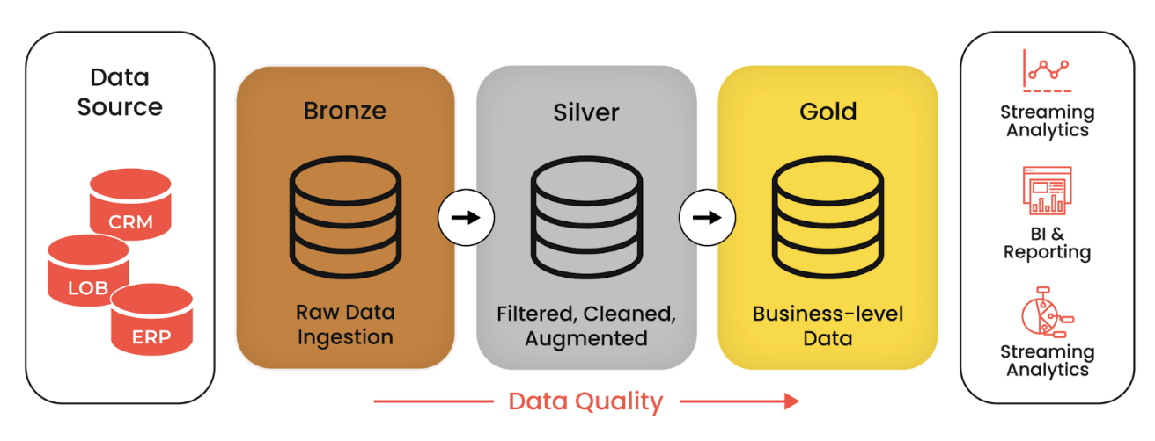

Slide 14
The data staging area of the data warehouse is both a storage area and a set of processes commonly referred to as extract-transformation-load (ETL). The data staging area is everything between the operational source systems and the data presentation area. It is somewhat analogous to the kitchen of a restaurant, where raw food products are transformed into a fine meal. In the data warehouse, raw operational data is transformed into a warehouse deliverable fit for user query and consumption. Similar to the restaurant’s kitchen, the backroom data staging area is accessible only to skilled professionals. The data warehouse kitchen staff is busy preparing meals and simultaneously cannot be responding to customer inquiries. Customers aren’t invited to eat in the kitchen. It certainly isn’t safe for customers to wander into the kitchen. We wouldn’t want our data warehouse customers to be injured by the dangerous equipment, hot surfaces, and sharp knifes they may encounter in the kitchen, so we prohibit them from accessing the staging area. Besides, things happen in the kitchen that customers just shouldn’t be privy to.
- Ralph Kimball( The Data Warehouse Toolkit)

Slide 15


